Slide 1

MICROFRONTENDS

Slide 2
Microservices: an intro to Microfrontends:
A small, independently deployable unit of a system that owns a single business capability, exposes an API, and manages its own data. Contrast with a monolith where all logic and data live in one deployable.
Monolith | Microservices
Simple to develop & debug | Independent scaling
Single deploy | Tech heterogeneity
Shared DB | Fault isolation
Scales as a whole | Complex ops (DevOps)
Tight coupling | Network latency
Communication types are either synchronous or asynchronous. Prefer async for writes/events, sync for queries needing immediate data
API Gateway: Single entry point for all clients. Handles: routing, auth, rate limiting, SSL termination, aggregation. Backends for Frontends (BFF) pattern => one gateway per client type.

Slide 3
Microservices: an intro to Microfrontends:
What is the difference between microservices and SOA(Service Oriented Architecture)?
SOA (Service-Oriented Architecture) services typically communicate over SOAP/ESB and share common data schemas. Microservices are finer-grained, communicate over lightweight protocols (REST/gRPC/messaging), each owns its own database, and are independently deployable. SOA often has a central "smart pipe" (ESB); microservices prefer "smart endpoints, dumb pipes".
What are the drawbacks of microservices?
Operational complexity requires orchestration (Kubernetes) and CI/CD pipelines per service.
Network latency — in-process calls become network calls.
Distributed debugging — hard without distributed tracing.
Data consistency — no ACID across services; eventual consistency adds complexity.
Testing — integration testing across many services is hard.
“It trades technical simplicity for organizational scalability."

Slide 4
Introduction
Microfrontends are transforming how teams build and deploy frontend applications at scale.
Good frontend development is hard. Scaling frontend development so that many teams can work simultaneously on a large and complex product is even harder.
Perhaps you want to build a progressive or responsive web application but can't find an easy place to start integrating these features into the existing code.
Perhaps you want to start using new JavaScript language features (or one of the myriad languages that can compile to JavaScript), but you can't fit the necessary build tools into your existing build process.
Or maybe you just want to scale your development so that multiple teams can work on a single product simultaneously, but the coupling and complexity in the existing monolith means that everyone is stepping on each other's toes.
Lately we are seeing more and more attention being paid to the overall architecture and organizational structures that are necessary for complex, modern web development

Slide 5
What are Microfrontends?
An architectural style where independently deliverable frontend applications are composed into a greater whole.
Some of the key benefits that we've seen from micro frontends are:
smaller, more cohesive and maintainable codebases
more scalable organizations with decoupled, autonomous teams
the ability to upgrade, update, or even rewrite parts of the frontend in a more incremental fashion than was previously possible
The overall idea is to move away from a big monolithic UI to decoupled UI codebases that can be owned, managed, and deployed by separate teams independently.
What can this piece of UI be
Pages – parts of a website owned by specific teams..
Components – Components like header and footer are good candidates for a microfrontend approach as well. They’re relatively static but need to stay consistent across the website and may integrate with teams who own different sets of pages.
Widgets – A recommendation widget may be owned by a recommendations team, for example, and it can be integrated into different parts of the page based on the context.

Slide 6
Incremental upgrades:
For many organizations this is the beginning of their micro frontends journey. The old, large, frontend monolith is being held back by yesteryear's tech stack, or by code written under delivery pressure, and it's getting to the point where a total rewrite is tempting
In order to avoid the perils of a full rewrite, we'd much prefer to strangle the old application piece by piece, and in the meantime continue to deliver new features to our customers without being weighed down by the monolith.
The existing code still needs to be maintained, and in some cases, it may make sense to continue to add new features to it, but now the choice is available.
The endgame here is that we're afforded more freedom to make case-by-case decisions on individual parts of our product, and to make incremental upgrades to our architecture, our dependencies, and our user experience.
If there is a major breaking change in our main framework, each micro frontend can be upgraded whenever it makes sense, rather than being forced to stop the world and upgrade everything at once.

Slide 7
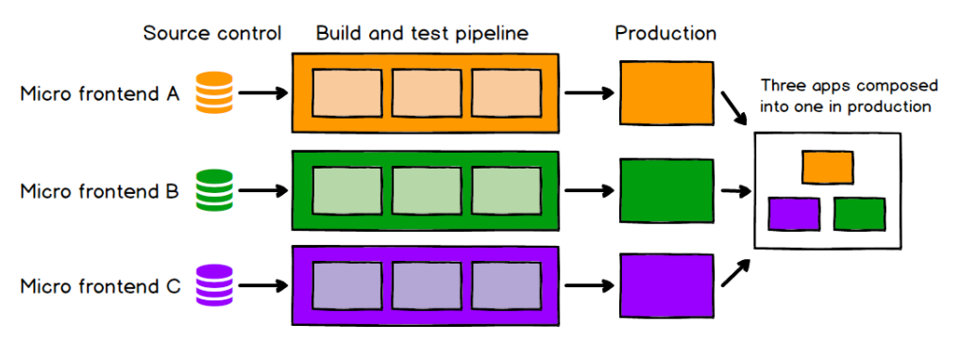
Independent deployment:
Just as with microservices, independent deploy ability of micro frontends is key. This reduces the scope of any given deployment, which in turn reduces the associated risk.
Regardless of how or where your frontend code is hosted, each micro frontend should have its own continuous delivery pipeline, which builds, tests and deploys it all the way to production.
If a given micro frontend is ready to go to production, it should be able to do so, and that decision should be up to the team who build and maintain it.

Slide 8
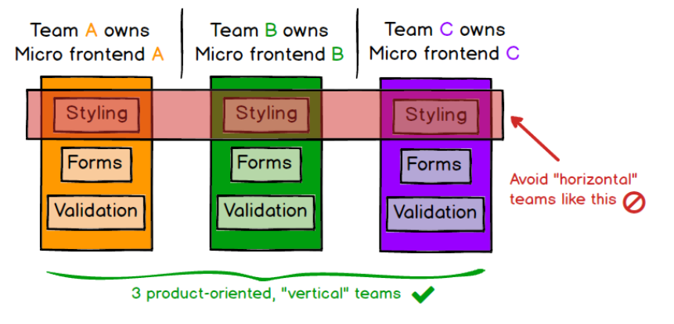
Autonomous teams:
As a higher-order benefit of decoupling both our codebases and our release cycles, we get a long way towards having fully independent teams, who can own a section of a product from ideation through to production and beyond.

Slide 9
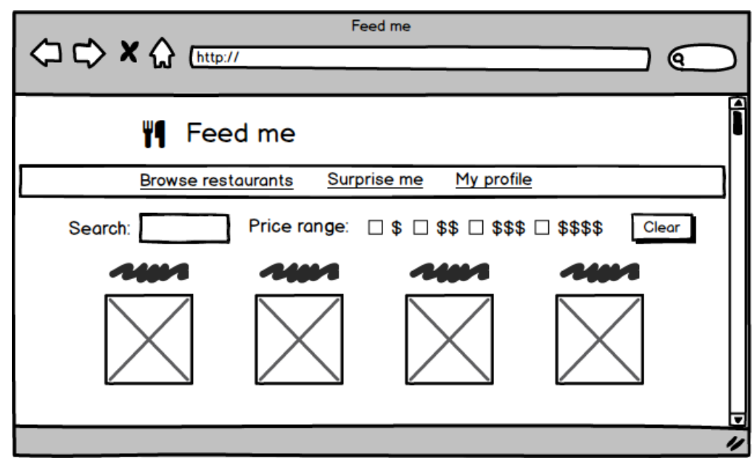
The example:
Imagine a website where customers can order food for delivery. On the surface, it's a fairly simple concept, but there's a surprising amount of detail if you want to do it well:

Slide 10
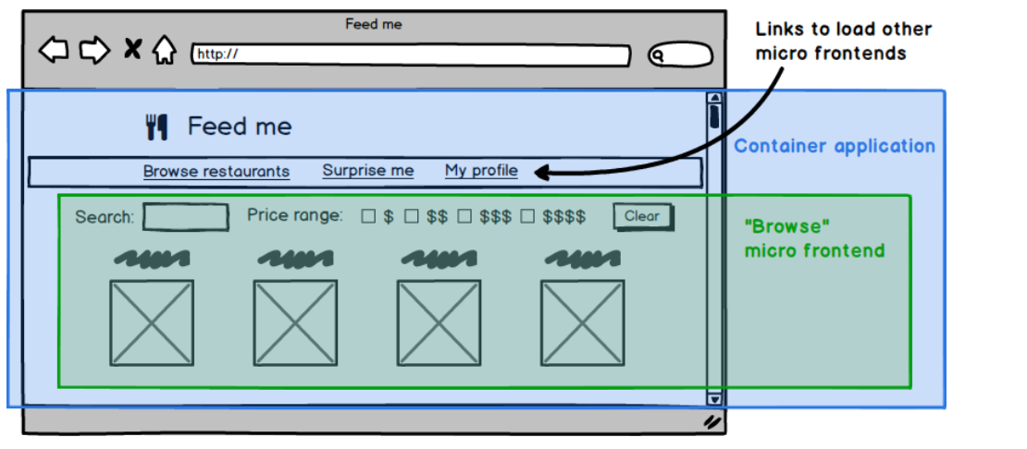
Integration approaches:

Slide 11
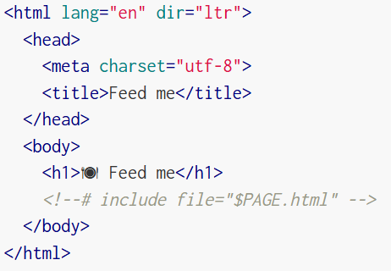
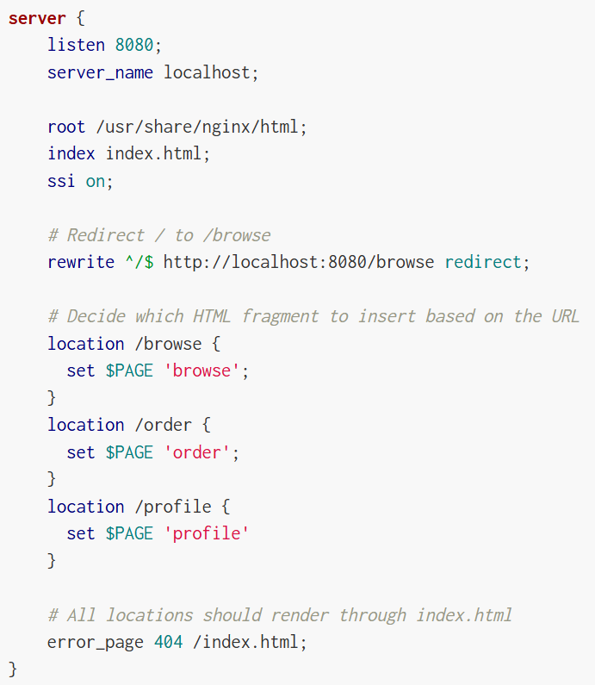
Server-side template composition:
What's not shown here is how those various HTML files end up on the web server, but the assumption is that they each have their own deployment pipeline, which allows us to deploy changes to one page without affecting or thinking about any other page.
This is fairly standard server-side composition. The reason we could justifiably call this micro frontends is that we've split up our code in such a way that each piece represents a self-contained domain concept that can be delivered by an independent team.

Slide 12
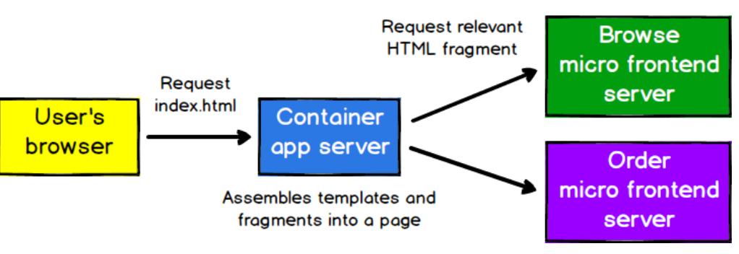
Server-side template composition:

Slide 13
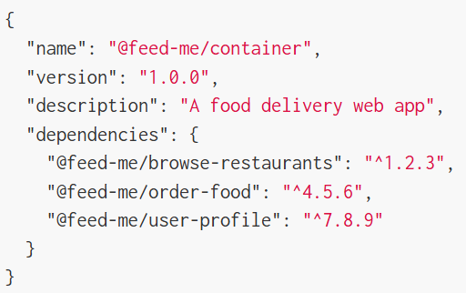
Build-time integration:
One approach that we sometimes see is to publish each micro frontend as a package and have the container application include them all as library dependencies.
produces a single deployable JavaScript bundle, as is usual, allowing us to de-duplicate common dependencies from our various applications. However, this approach means that we have to recompile and release every single micro frontend to make a change to any individual part of the product.

Slide 14
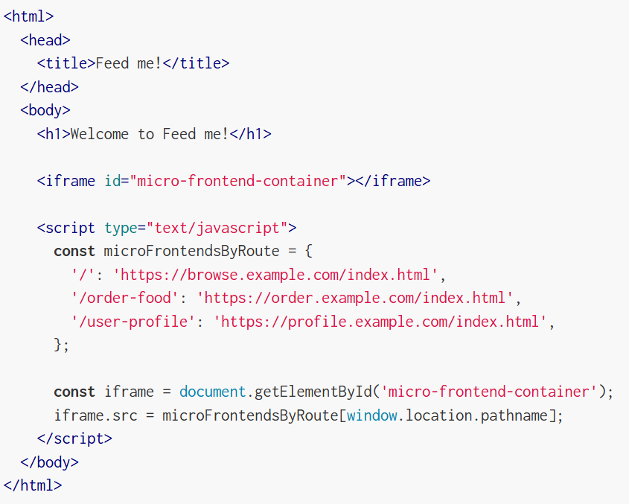
Run-time integration via iframes:
By their nature, iframes make it easy to build a page out of independent sub-pages. They also offer a good degree of isolation in terms of styling and global variables not interfering with each other.

Slide 15
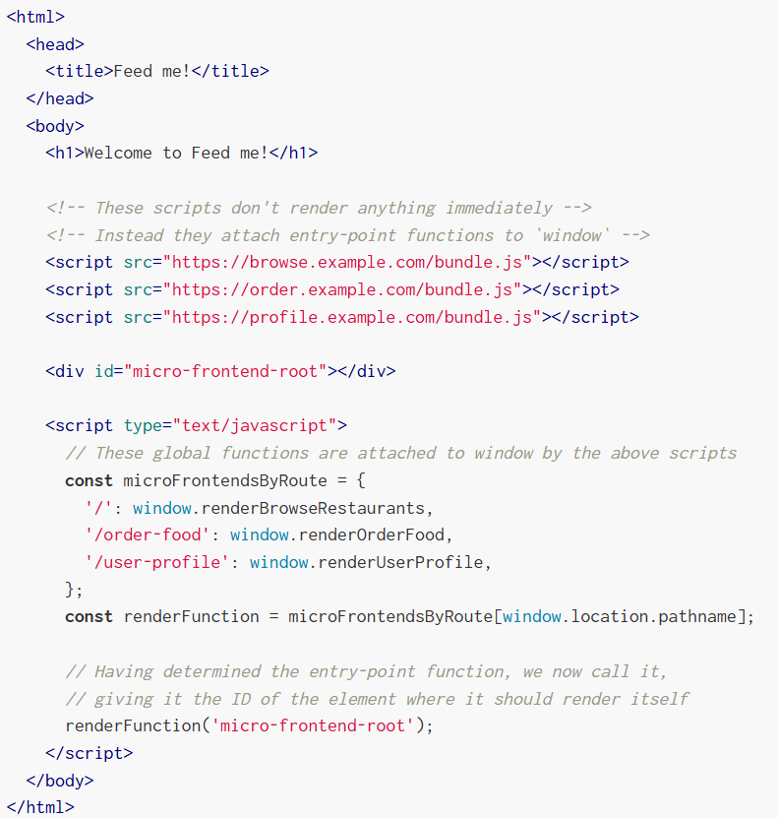
Run-time integration via JavaScript:
Each micro frontend is included on the page using a <script> tag, and upon load exposes a global function as its entry-point.

Slide 16
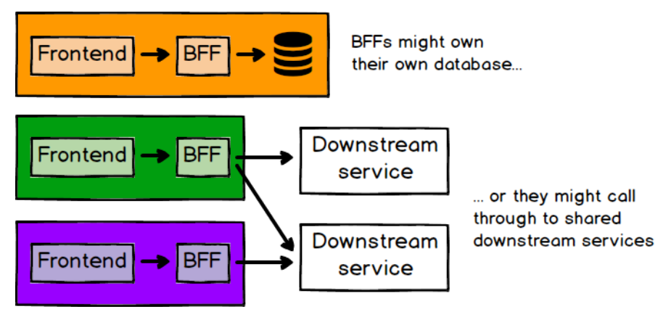
Backend Communication (Backend For Fronts):
One pattern that helps here is the BFF pattern, where each frontend application has a corresponding backend, whose purpose is solely to serve the needs of that frontend.
The BFF might be self-contained with its own business logic and database, or it might just be an aggregator of downstream services.
The guiding principle here is that the team building a particular micro frontend shouldn't have to wait for other teams to build things for them.

Slide 17
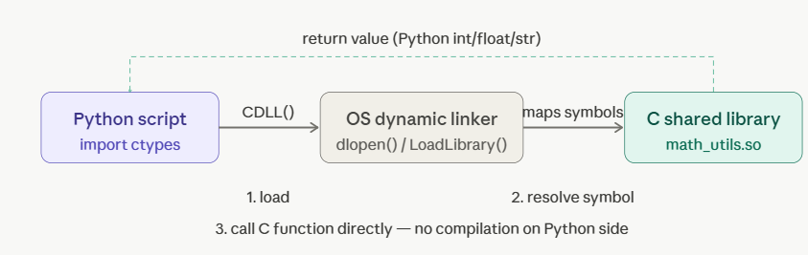
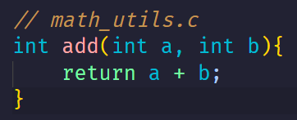
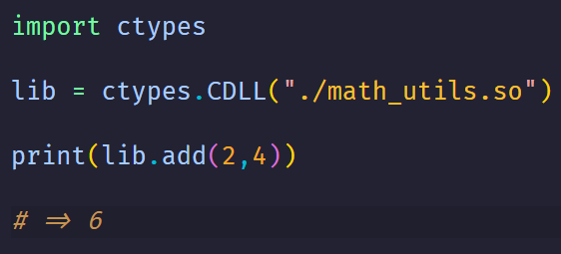
C & Python:
1. ctypes — the simplest flow. Your C code compiles to a shared library, Python loads it at runtime, and calls flow directly through the OS loader.

Slide 18
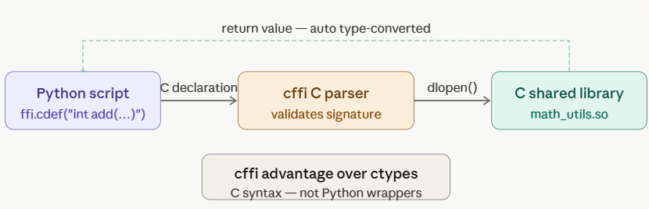
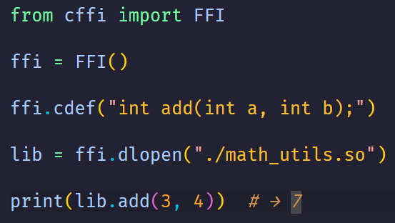
C & Python:
2. cffi — same idea as ctypes, but you hand it the C function signature as a string. Cffi parses it, builds a binding internally, and then the OS linker does the same job. cleaner API, popular in real projects

Slide 19
References:
https://martinfowler.com/articles/micro-frontends.html
https://www.youtube.com/watch?v=lKKsjpH09dU

Slide 20
THANK YOU

